Slide 1

1
2
0
4
5
3

Slide 2
Enjoy The Presentation

Slide 3




Information & Communication Technology
Realised by Group 22
ICT
03/01/2024
USTHB

Slide 4
1
4
Impact
Introduction
Components
2
5
Tools
Plan
3
6
Role In Society
Conclusion

Slide 5

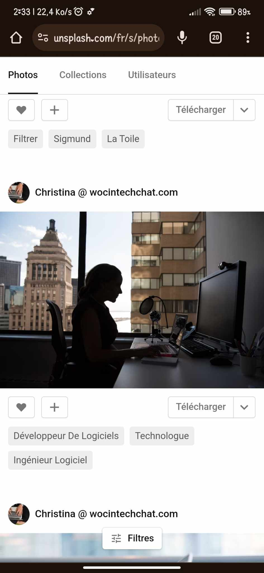
INTRODUCTION:
Understanding ICT doesn't require mastering every technical detail. But by appreciating its broad reach and potential, we can become more informed users, responsible citizens, and active participants in shaping a future where technology serves humanity for the greater good.
So, whether you're a tech enthusiast or a curious newcomer, welcome to the fascinating world of ICT ! It's a journey worth exploring, with limitless possibilities waiting to be discovered.
Group 22

Slide 6


What is ICT ?
Information and communication technologies (ICT) is an umbrella term that encompasses all the technologies used for the acquisition, processing, storage, and transmission of information.
.
This is the broadest definition, encompassing all the technologies used for the acquisition, processing, storage, and transmission of information. This includes everything from computers and mobile devices to networks, software, and the internet itself.

Slide 7






Slide 9


Negative Impacts:
Positive Impacts:
Digital Divide,
Addiction and Mental Health,
Cybersecurity Threats,
Global Collaboration
Job Displacement,
Engaging Learning Experiences
Ethical Considerations
Personalized Learning
Remember, ICT is just a tool. How we use it is what truly matters. Let's strive to harness the power of ICT for positive change and create a better world for all.
Democratization of Knowledge
Empowering Communities

Slide 10








Google services
Google art and culture:
allows users
to explore and experience art, culture, and
historical artefacts from around the world.
Google translate:
Users can input text in one language and receive the translated text in another language. This can be done for individual words, phrases, sentences, or entire documents.
Google books:
is a digital library and online service offered by Google, enabling users to search, preview, and
read a vast collection of
books.
Google maps :
is a web-based mapping service provided by Google that offers various features related to geographic mapping, navigation, and location-based services. It allows users to view maps, get directions, find local businesses, and more.
Google cloud:
is a comprehensive suite of cloud computing services provided by Google. These services include infrastructure as a service (IaaS), platform as a service (PaaS), and software a service (SaaS) offerings.
YouTube :
is a video-sharing platform and website that allows users
to upload, share, and view videos. It was created in
February 2005 and later acquired by Google in November 2006. YouTube has become one of the most popular and widely used online platforms for sharing video content.
Gmail:
is a free web-based email service provided by Google. It was first introduced as an invitation-only beta release on April 1, 2004, and later became available to the public on February 7, 2007. Gmail quickly gained popularity due to its innovative features, large storage capacity, and efficient search capabilities.

Slide 14




Conclusion:
ICT has profoundly transformed our world, offering immense potential for progress and development. However, we must navigate its challenges responsibly, ensuring equitable access, addressing ethical concerns, and mitigating potential harms. The future of I ICT lies in harnessing its power for good, while safeguarding against its downsides.

Slide 15


Thank you for your attention

